Slide 1
INST 414: Data Science Techniques Lecture 1 Introduction

Slide 2
Logistics
Class is 1 hours and 15 minutes
Plan:
Thursdays: Lecture
Fridays: Discussion Sections
TAs:
Marilyn Harbert (mharbert)
Kem Nguyen-Le (nlpa)
UTA:
Josephine Whittington (jwhitt)
Office Hours: TBD + By Appointment

Slide 3

About Me
Assistant Professor at the iSchool and CCJS
Ph.D. in Computer Science from NYU in 2017
Before UMD:
Research areas:
ML in public policy, particularly criminal justice
Record linkage
Science of science
You can refer to me by:
Professor Jelveh, Dr. Jelveh, or Zubin

Slide 4
What is data science?

Slide 5
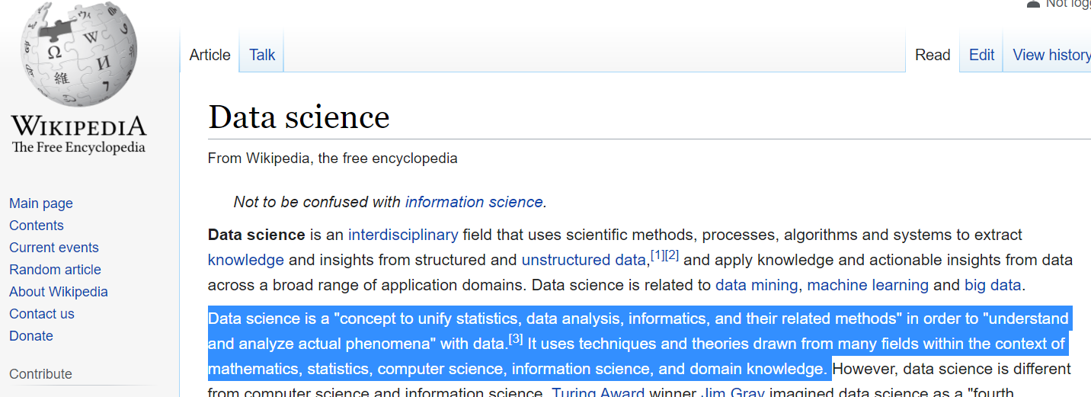
I love Wikipedia, but…

Slide 6
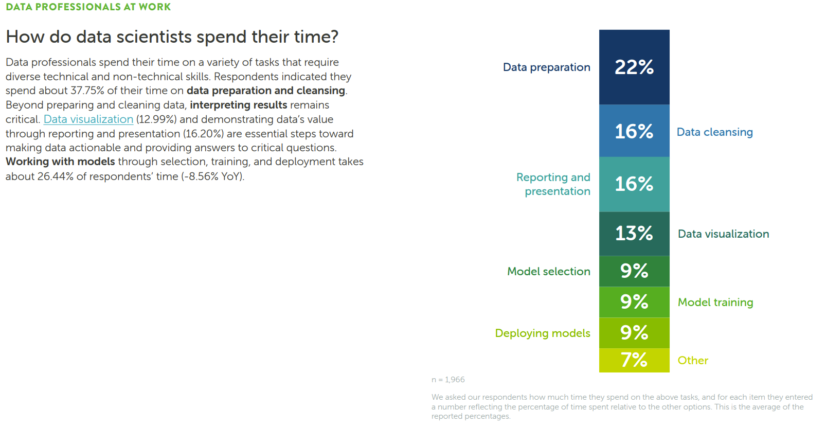
Source: Anaconda State of Data Science Survey (2022)

Slide 7


Data Science = Prediction
Detect
Facial recognition
License plate readers
Voice recognition
Forecast
Pretrial
Credit Score
Calcium Score
Predictive policing

Slide 8
Detecting Is Much Easier Than Forecasting
Detect
Face Recognition Vendor Test:
False Non-Match Rates ~ $0\%$ error
License plate readers:
Wang et al. (2022) < 1% error
Forecast
Pretrial release:
Kleinberg et al. (2018) – 44% of top risk percentile do not FTA
Shooting victimization:
Heller et al. (2023) – 87% of top 500 are not victims

Slide 9
Pretrial Risk Assessments

Slide 10
Bail/Pretrial Detention
When a person gets arrested, they go in front of a judge who decides whether the person will be detained or released while the case works its way through the court
Often this decision is based on flight or public safety risk:
Will the defendant be re-arrested during this pretrial period?
Will the defendant not show up at a future court date?
Both of these questions are essentially predictions/forecasts

Slide 11
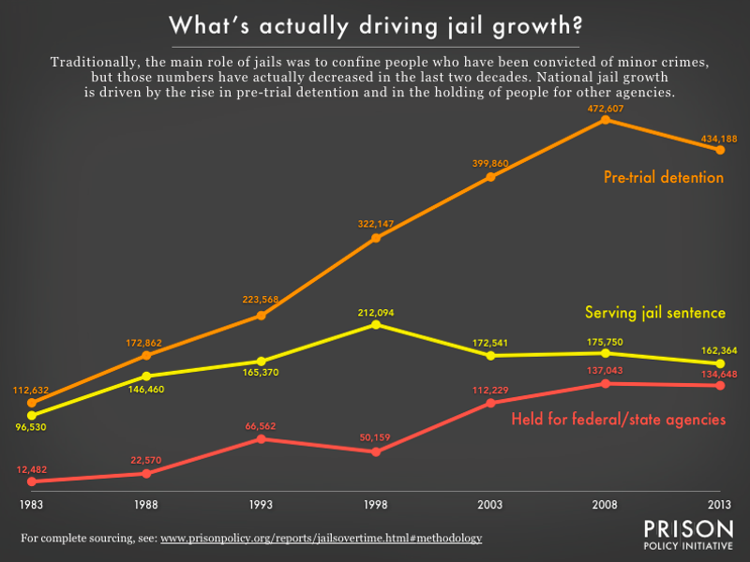
Background
The pretrial jail population in the U.S. increased 400% over 3 decades.
Driven by the use of cash bail
Source: https://www.prisonpolicy.org/reports/jailsovertime.html

Slide 12
Solution
Reduce use of cash bail (examples: NJ, Maryland)
Use algorithms to assess risk
Public Safety Assessment

Slide 13
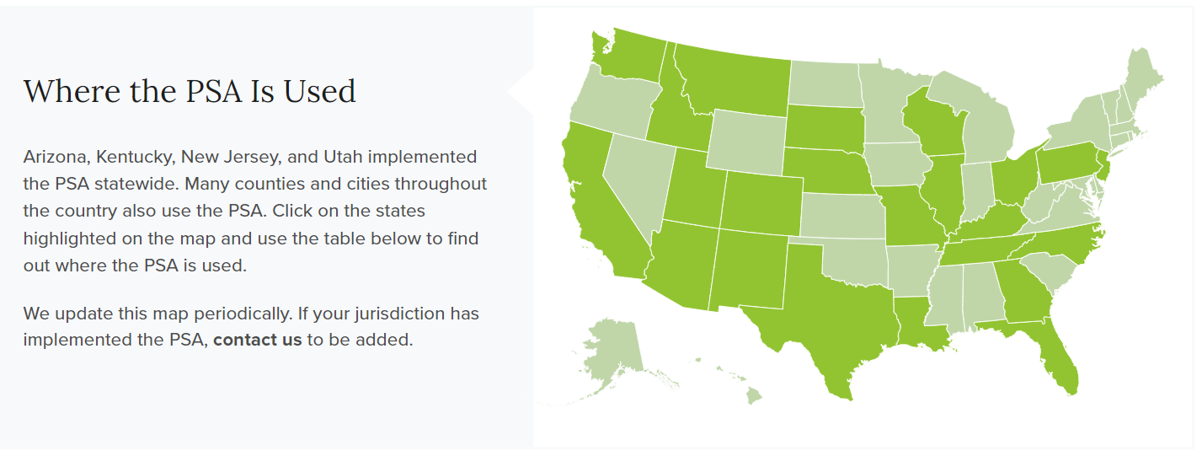
Solution
Reduce use of cash bail (examples: NJ, Maryland)
Use algorithms to assess risk
Public Safety Assessment (PSA)

Slide 14

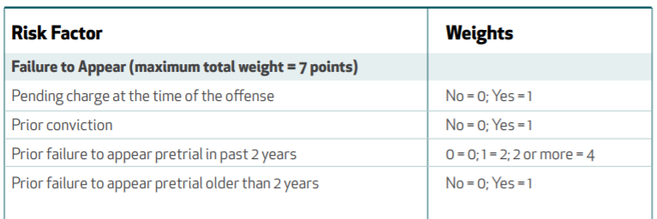
Public Safety Assessment

Slide 15
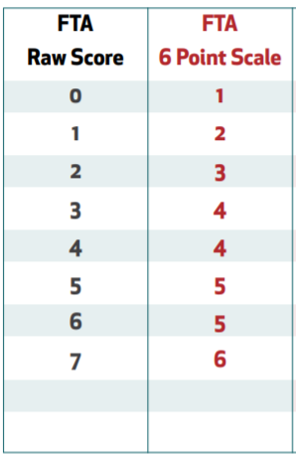
Public Safety Assessment

Slide 16
Scoring
Defendant arrested on a harassment charge
Had one prior violent conviction
Had one failure to appear last year
Had no pending charges
What is this defendant’s FTA score?

Slide 17
Scoring
Defendant arrested on a harassment charge
Had one prior violent conviction
Had one failure to appear last year
Had no pending charges
What is this defendant’s FTA score?

Slide 18
Scoring
Defendant arrested on a harassment charge
Had one prior violent conviction
Had one failure to appear last year
Had no pending charges
What is this defendant’s FTA score?
0 + 1 + 2 + 0 = 3

Slide 19
Course Roadmap

Slide 20
Course Roadmap
Predicting a 0-1 outcome
What is the chance that some outcome (rearrest) will happen?
Probability
Marginal, Joint, Conditional probabilities
Bayes Theorem
Weighted Averages / Expected Probabilities

Slide 21
Course Roadmap
Evaluating Algorithms I :
Predictive accuracy
Algorithms
Naïve Bayes
Linear and Logistic Regression
Cross-validation / Hyperparameter Tuning / Bias-variance Tradeoff
Decision Trees
Random Forest / Gradient Boosting
Evaluating Algorithms II
Fairness
Impact

Slide 22
Course Roadmap
Last part of the course:
Text-mining
Vector-space model
What are large language models doing?

Slide 23
What This Course Does Not Cover
Other machine learning approaches:
Social network analysis
Recommendation systems
Deep learning

Slide 24
On the Coding Side
Learning Objectives:
Jupyter Notebooks
Pandas (data manipulation)
Scikit-Learn (ML models)
Seaborn (visualization)
Feature Engineering

Slide 25
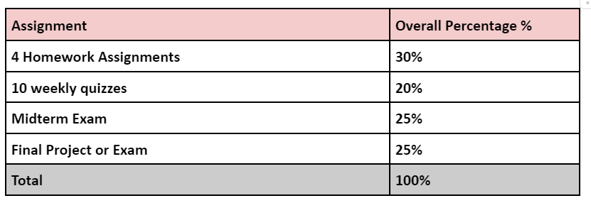
Content + Grading

Slide 26
Data Science Process

Slide 27
Data Science Process
What decision is the algorithm trying to help with?
For example: Likelihood that defendant will not show up at next court date (Failure To Appear)
Choose an outcome to predict
Get some examples of this outcome
Get court records and measure when someone doesn’t show up
Build predictive features
Use data to predict FTA (e.g. prior FTA, type of current charge, social connections, age, etc.)
Define your goal (technical jargon: objective function)
Limit FTAs? Limit FTAs for Felonies? Limit FTAs for Misdemeanors?
Optimize an algorithm
Build algorithm that generates predictions that best meet objective
Deploy algorithm

Slide 28
Data Science Process
What decision is the algorithm trying to help with?
For example: Likelihood that defendant will not show up at next court date (Failure To Appear)
Choose an outcome to predict
Get some examples of this outcome
Get court records and measure when someone doesn’t show up
Build predictive features
Use data to predict FTA (e.g. prior FTA, type of current charge, social connections, age, etc.)
Define your goal (technical jargon: objective function)
Limit FTAs? Limit FTAs for Felonies? Limit FTAs for Misdemeanors?
Optimize an algorithm
Build algorithm that generates predictions that best meet objective
Deploy algorithm

Slide 29
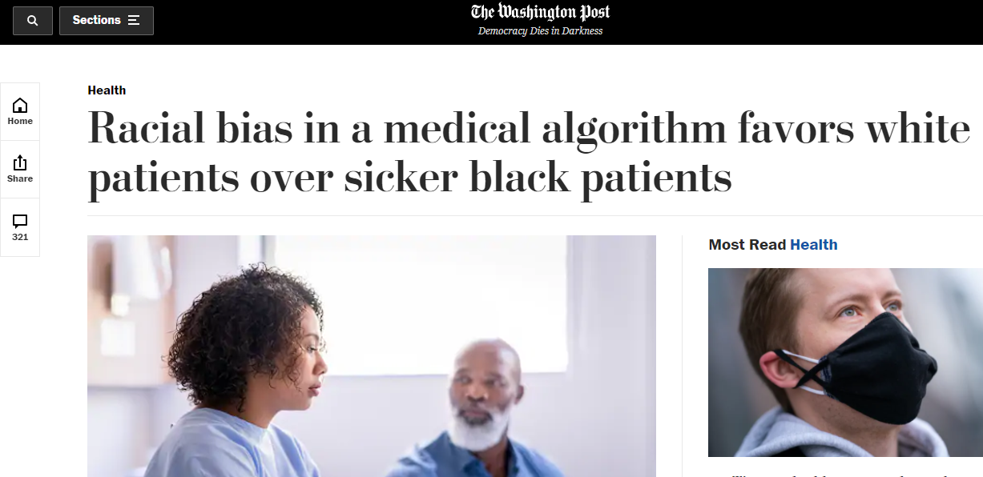
Link to paper

Slide 30
Racial Bias in Medical Algorithms
Goal was to allocate healthcare resources based on need
How do you measure need?
Algorithm designers chose healthcare utilization
But White patients are more likely to access healthcare than Black patients
Upshot: For the same risk level, Black patients were actually at greater risk of bad outcomes than White patients

Slide 31
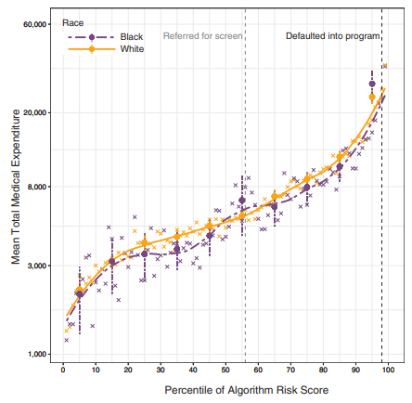
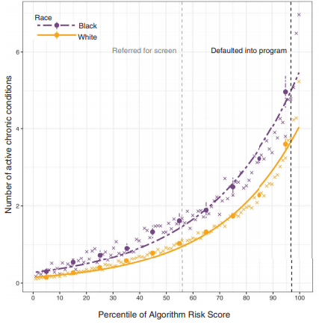

Slide 32
Data Science Process
What decision is the algorithm trying to help with?
For example: Likelihood that defendant will not show up at next court date (Failure To Appear)
Choose an outcome to predict
Get some examples of this outcome
Get court records and measure when someone does/n’t show up
Build predictive features
Use data to predict FTA (e.g. prior FTA, type of current charge, social connections)
Define an objective function
Limit FTAs? Limit FTAs for Felonies? Limit FTAs for Misdemeanors?
Optimize an algorithm
Build algorithm that generates predictions that best meet objective
Deploy algorithm

Slide 33

Crime and Victimization Risk Model

Slide 34
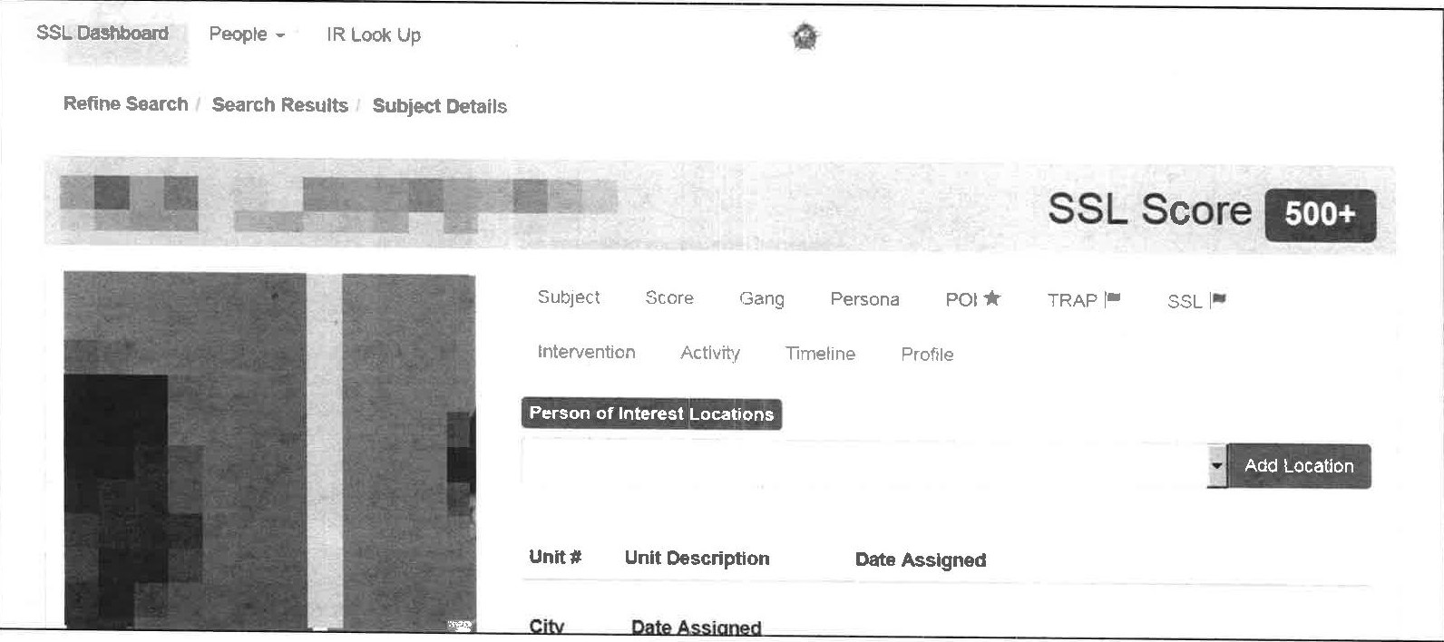
CRVM/SSL Screenshot

Slide 35
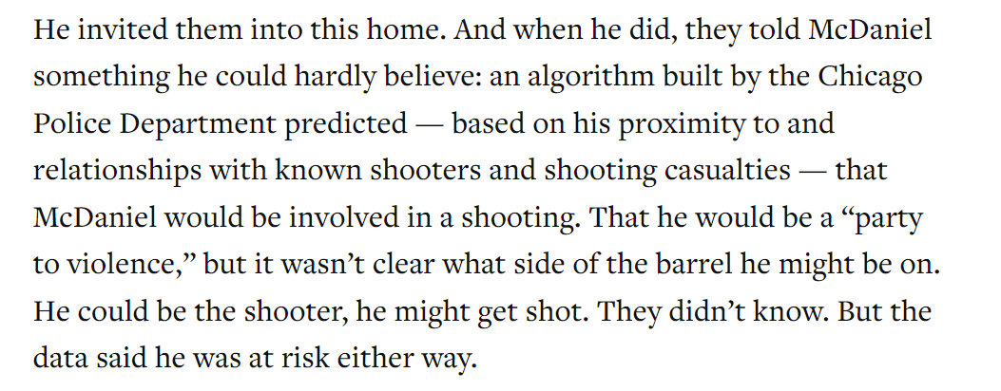
Self-fulling Prophecy?

Slide 36
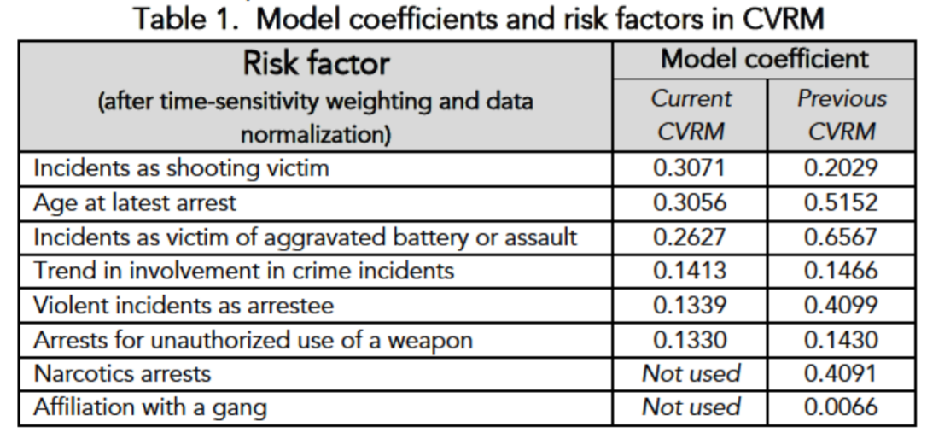
Model Factors

Slide 37
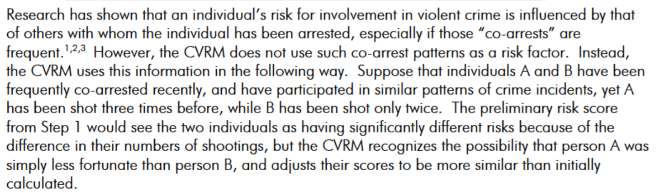
Where Do Networks Come In?

Slide 38
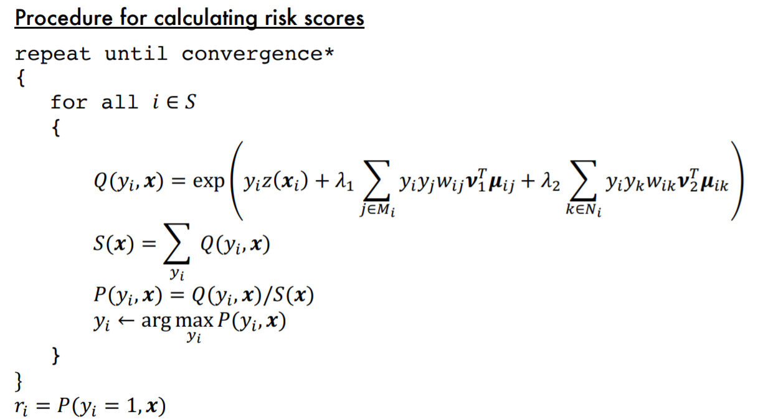
The Algorithm

Slide 39
Recap
This course is about predicting a Yes/No outcome
To do that we need to know:
Basic probability
What criteria makes a “good” algorithm
Which algorithms meet some of these criteria
Is this prediction:
More accurate than the status quo (typically human predictions)
Is this algorithm fair/equitable?
Does this algorithm help meet the larger objective?

Slide 40
Course Philosophy
Introduction to data science prediction
Concepts I want you to understand by the end of the course:
Prediction = Conditional Probability (or Expectation if we are talking about continuous outcomes)
How do we generate predictions with ML algorithms?
What qualities do we want in a good prediction?
How do we evaluate algorithms for those qualities?
How do we evaluate algorithms when the underlying data is biased?
These concepts are applicable to other ML approaches (text-mining / deep learning, etc)

